Slide 1
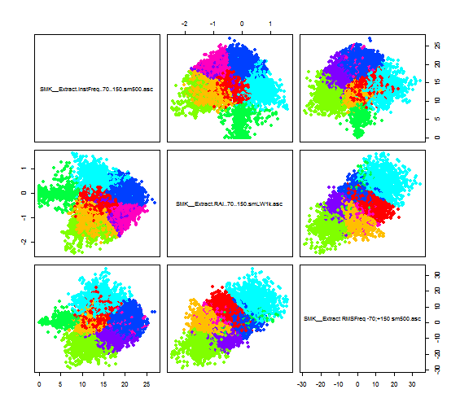
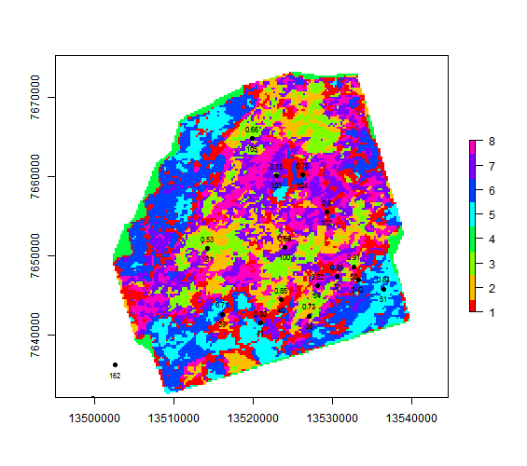
K-means clustering

Slide 2
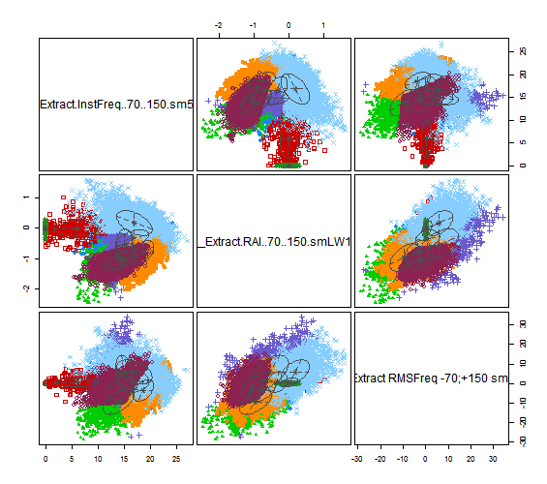
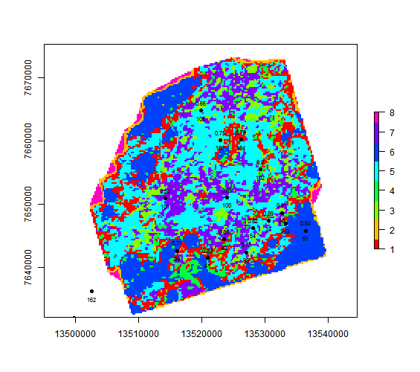
GMM clustering

Slide 3
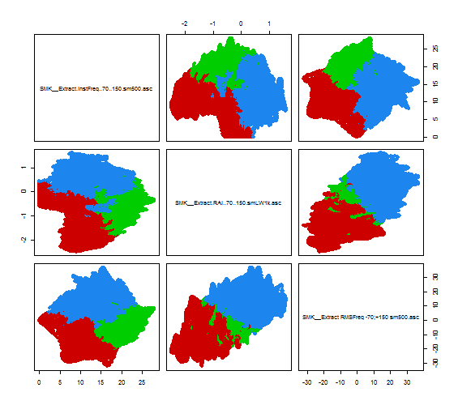
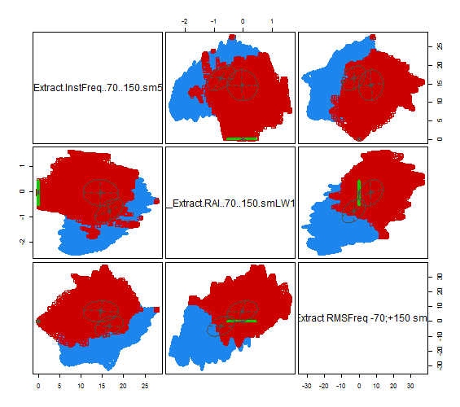
Key difference
K-Means:
fuzzy and sometimes illogical splitting of the classes especially when number of classes is low.
GMM K-Means:
Even statistically small classes with significant distribution difference are successfully separated from background data.

Slide 4
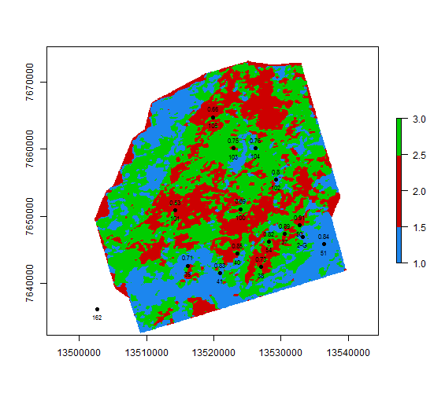
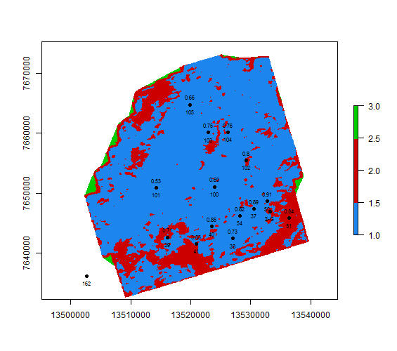
Key difference – Instantaneous attributes with artifacts
K-Means:
Border/edge artifacts were incorporated in the possibly meaningful cluster (red)
GMM K-Means:
Border/edge artifacts are successfully separated from the meaningful data

Slide 5
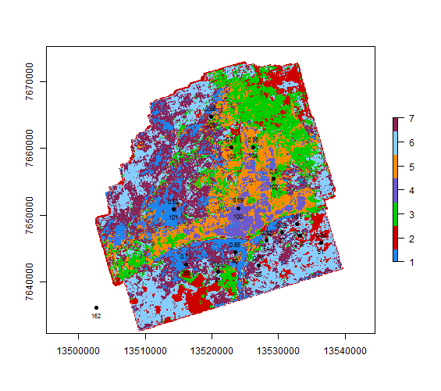
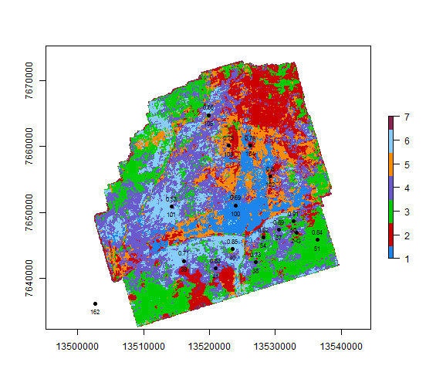
Key difference – spectral decomposition clustering
K-Means 7 classes:
GMM K-Means 7 classes:

Slide 6
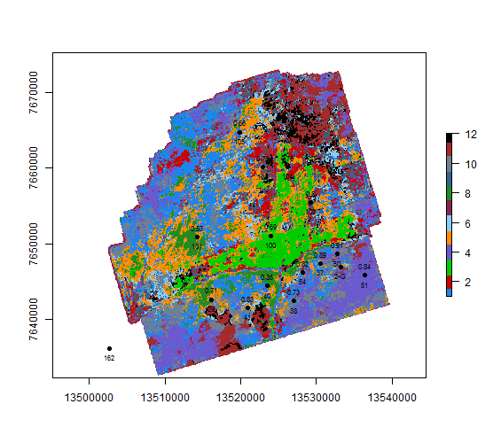
Key difference – spectral decomposition clustering
K-Means:
GMM K-Means (automatic classes):

Slide 7
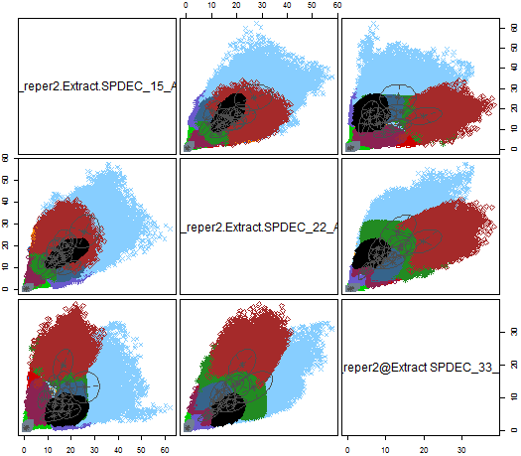
Key difference – spectral decomposition clustering

Slide 8
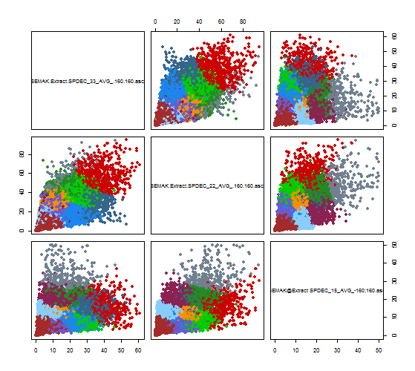
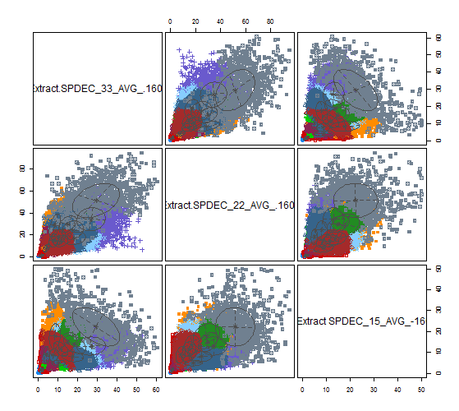
Key difference – spectral decomposition (15-22-33)

Slide 9
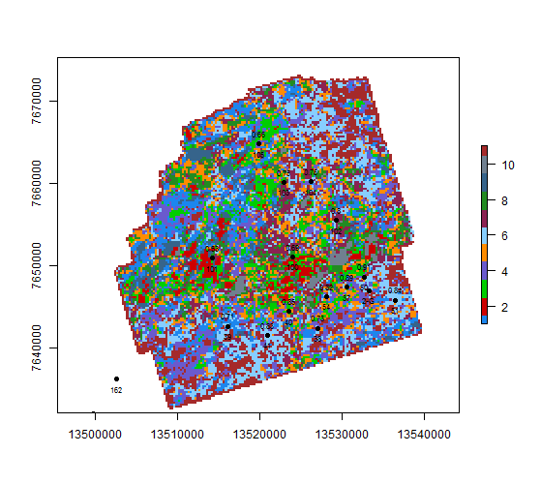
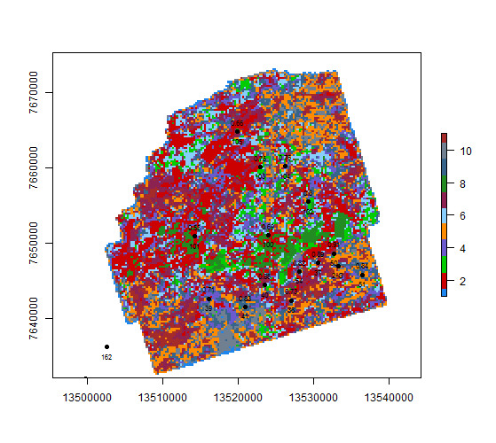
Key difference – spectral decomposition (15-22-33)

Slide 10
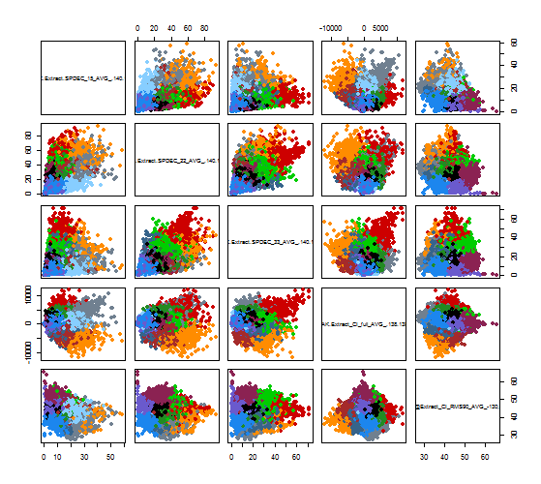
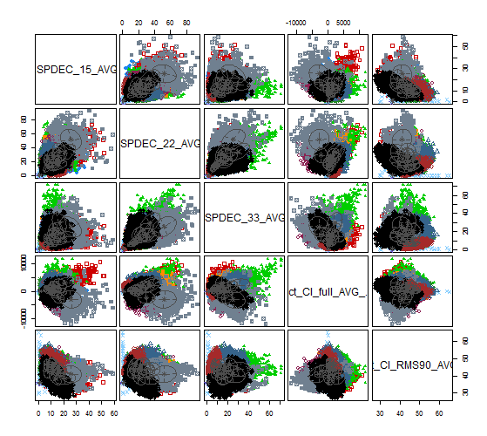
Key difference – PK_r2 + 140ms

Slide 11
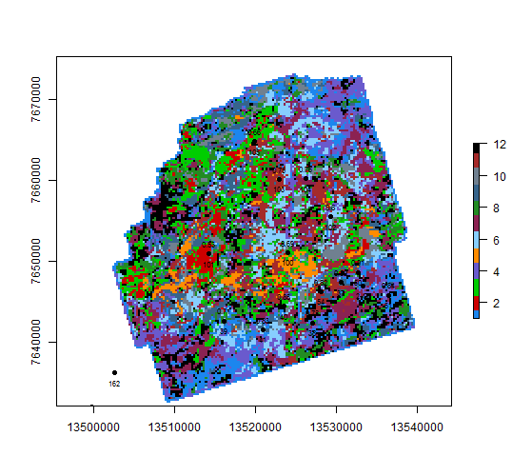
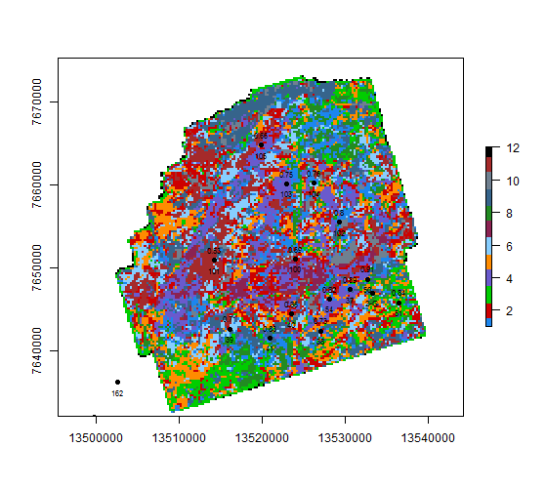
Key difference – PK_r2 + 140ms

Slide 12
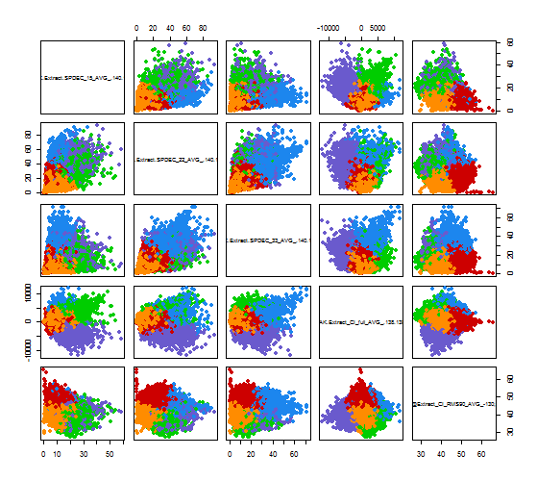
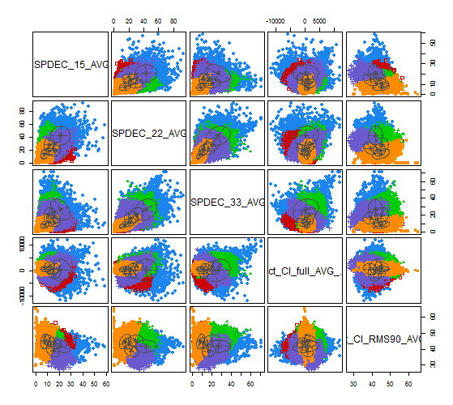
Key difference – PK_r2 + 140ms

Slide 13
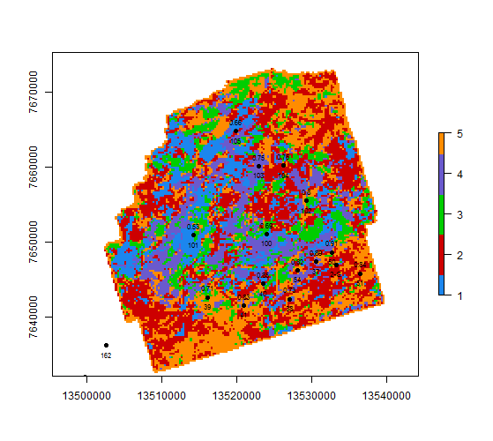
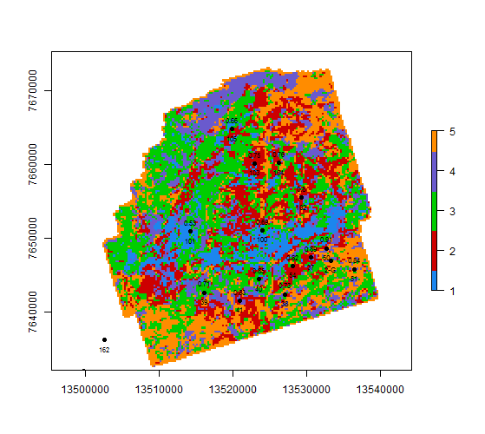
Key difference – PK_r2 + 140ms

Slide 14
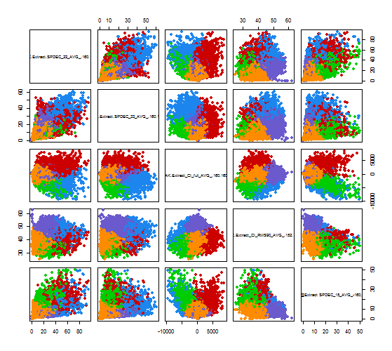
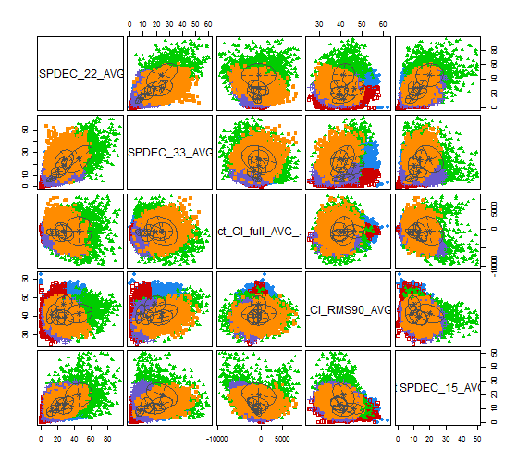
Key difference – PK_r2 + 160ms

Slide 15
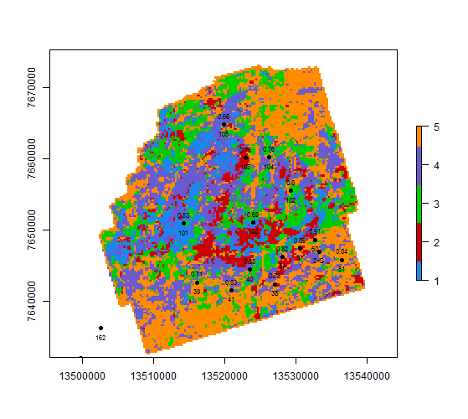
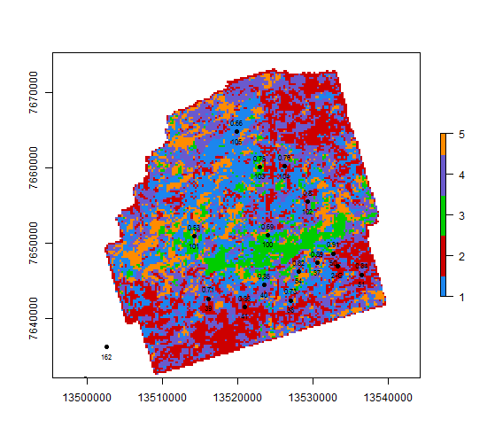
Key difference – PK_r2 + 160ms

Slide 16
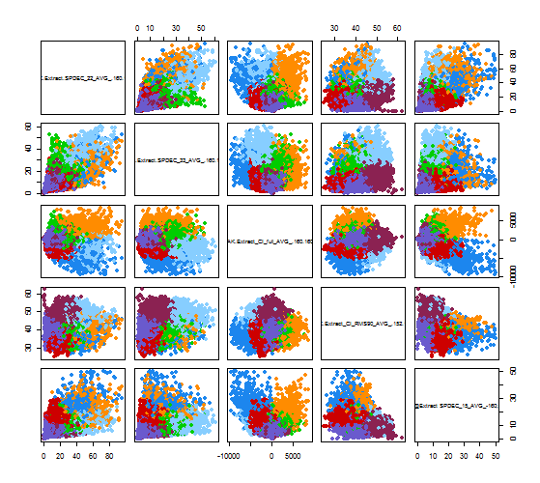
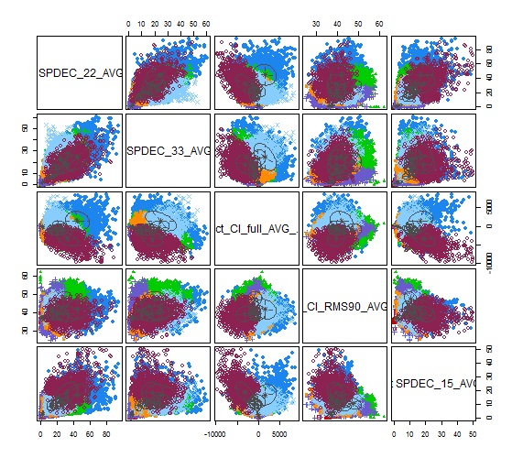
Key difference – PK_r2 + 160ms

Slide 17
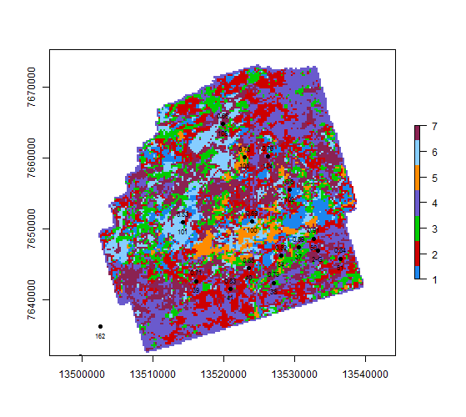
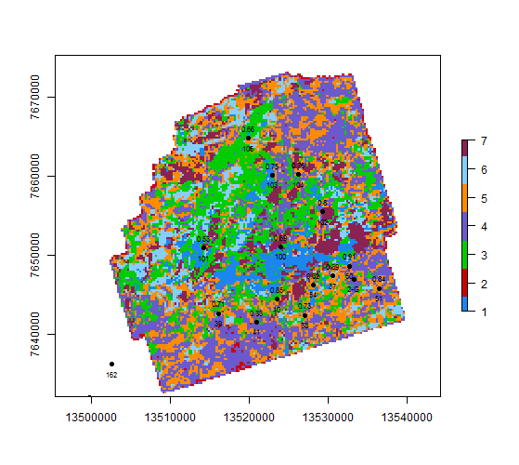
Key difference – PK_r2 + 160ms

Slide 18
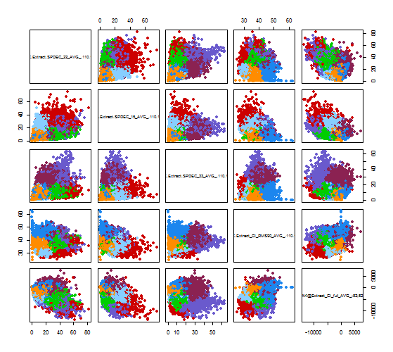
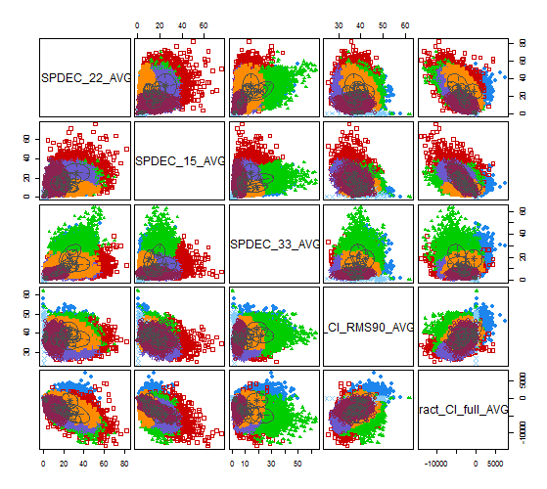
Key difference – PK_r2 + 120ms

Slide 19
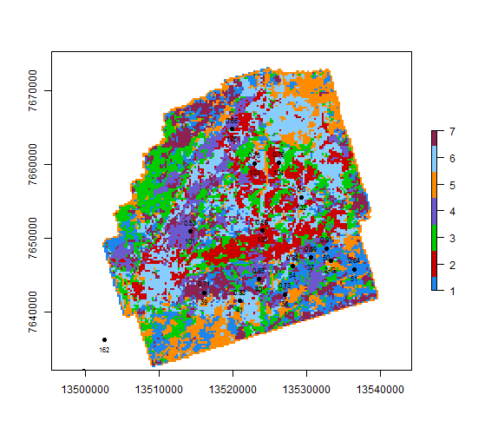
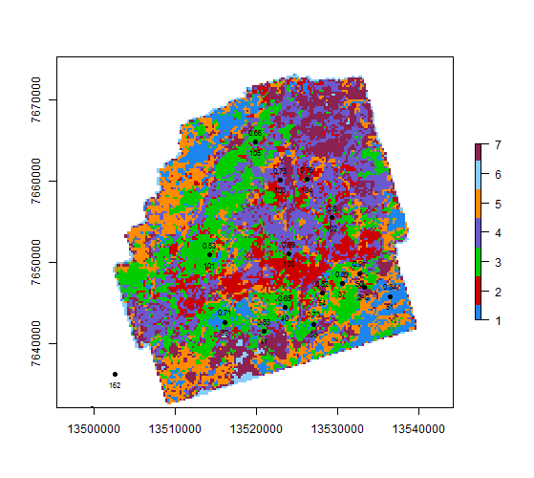
Key difference – PK_r2 + 120ms

Slide 20
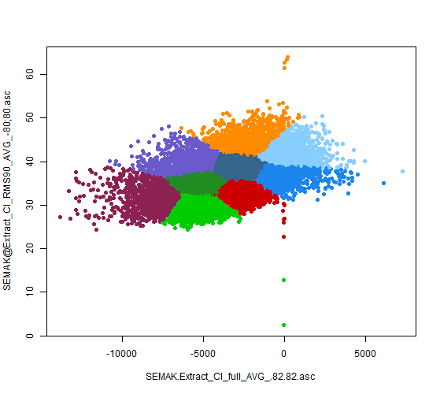
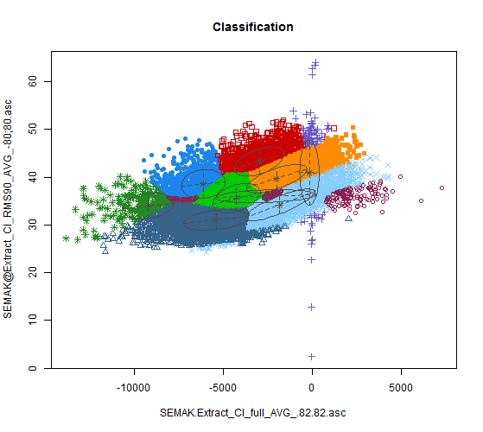
Key difference – PK_r2 + 80ms

Slide 21
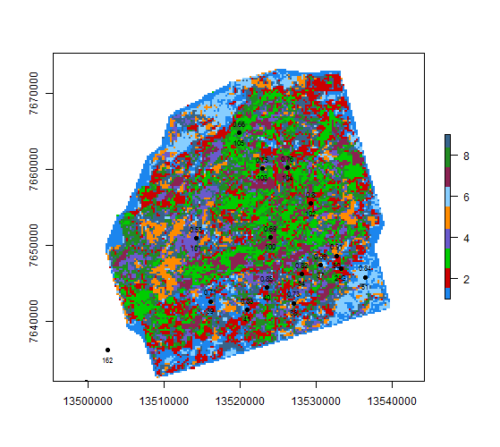
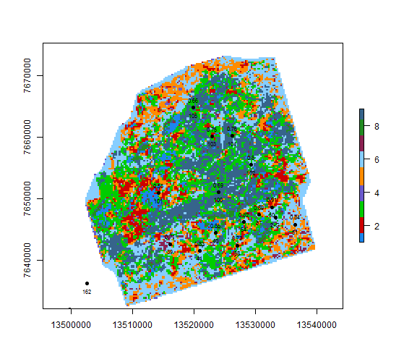
Key difference – PK_r2 + 80ms

Slide 22
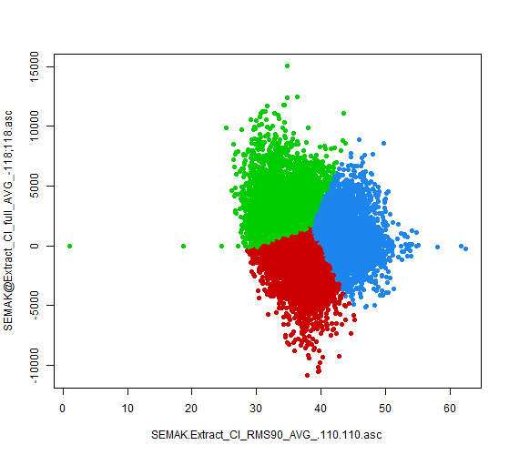
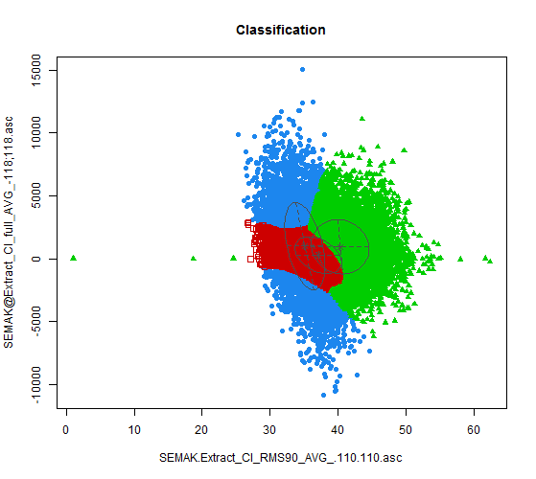
Key difference – PK_r2 + 80ms

Slide 23
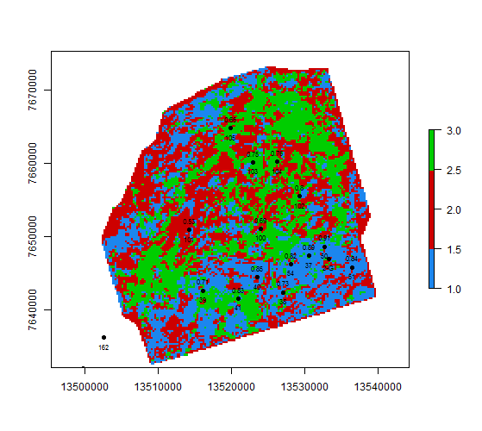
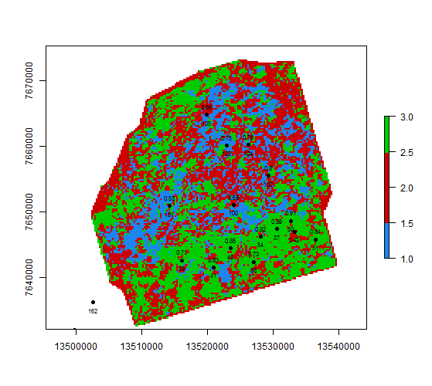
Key difference – PK_r2 + 80ms

Slide 24
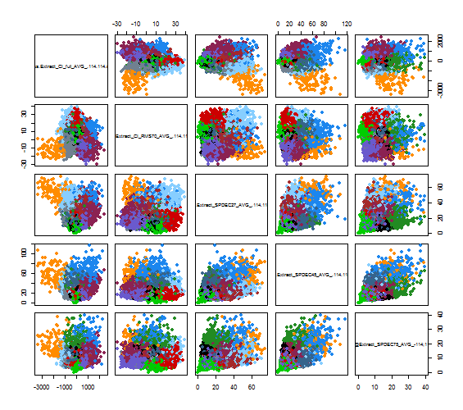
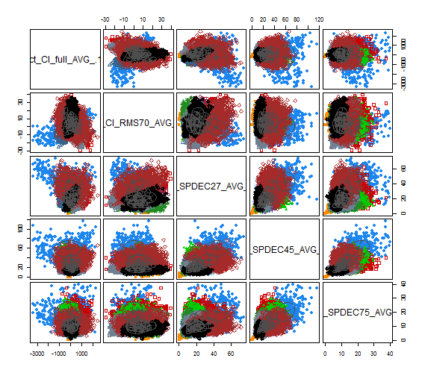

Slide 25
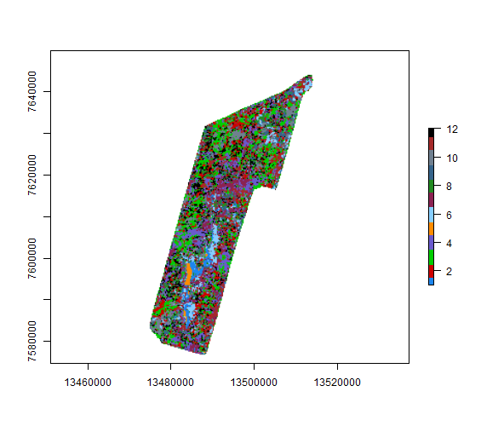
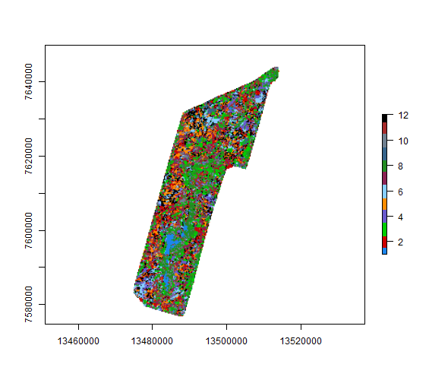

Slide 26
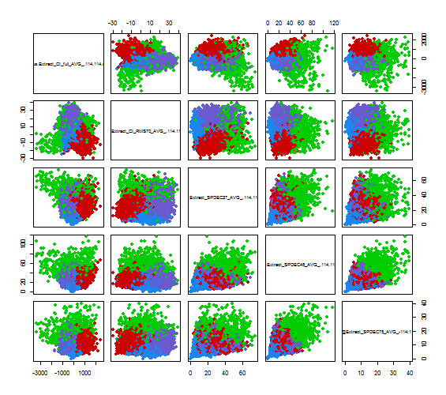
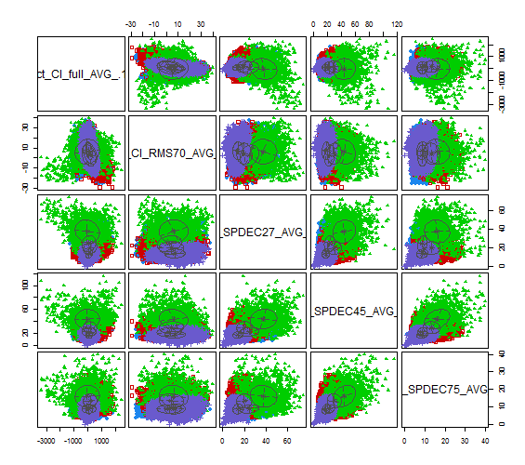

Slide 27



Slide 28



Slide 29



Slide 30


Semak SpDec+CI+CI_RMS C4 + 140ms

Slide 31


Semak SpDec+CI+CI_RMS C4 + 140ms

Slide 32


Semak SpDec+CI+CI_RMS C4 + 110ms

Slide 33


Semak SpDec+CI+CI_RMS C4 + 110ms

Slide 34

Semak SpDec+CI+CI_RMS C4 + 110ms

Slide 35


Semak SpDec+CI+CI_RMS C4 + 110ms

Slide 36



Slide 37



Slide 38


Slide 39



Slide 40



Slide 41

class : RasterLayer
dimensions : 501, 274, 137274 (nrow, ncol, ncell)
resolution : 150, 150 (x, y)
extent : 13473488, 13514588, 7574823, 7649973 (xmin, xmax, ymin, ymax)
coord. ref. : NA
data source : in memory
names : K.means.clustering.with.6.clusters.of.sizes.7464..6364..11942..9366..6345..5536
values : -2748.45, 2858.335 (min, max)
iClasses Values
1 1 NA
2 6 0.2410000
3 5 0.3420000
4 4 0.4548013
5 3 0.5000000
6 2 0.8169381

Slide 42

class : RasterLayer
dimensions : 501, 274, 137274 (nrow, ncol, ncell)
resolution : 150, 150 (x, y)
extent : 13473488, 13514588, 7574823, 7649973 (xmin, xmax, ymin, ymax)
coord. ref. : NA
data source : in memory
names : layer
values : 1, 6 (min, max)
iClasses Values
1 2 NA
2 4 0.3413081
3 6 0.4260000
4 1 0.4550000
5 3 0.5000000
6 5 0.8169381

Slide 43



Slide 44



